Slide 1
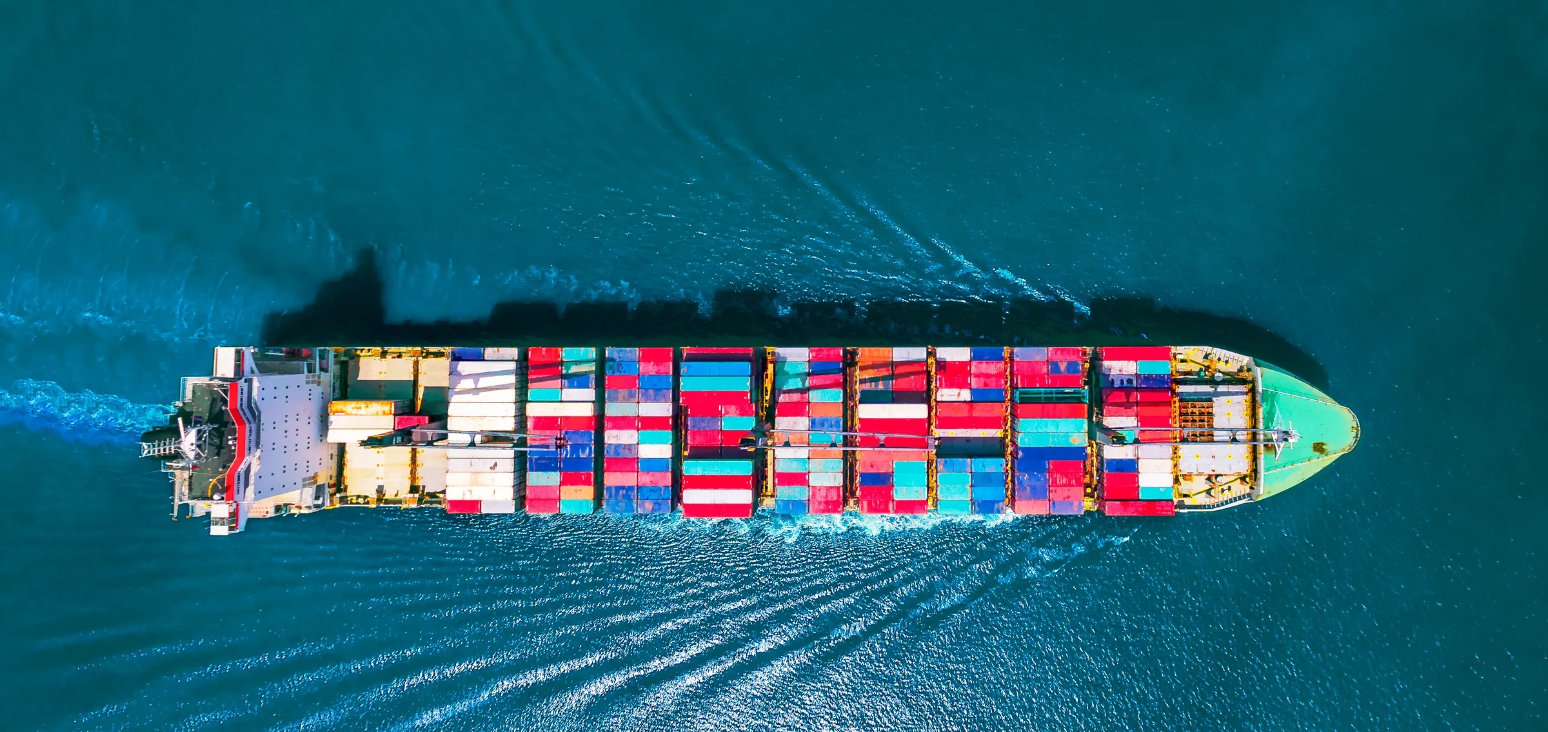
Name of school
SCL STEM Lesson 1 – Cardboard Boat Challenge
SCL
Notes:
Cover Slide.

Slide 2
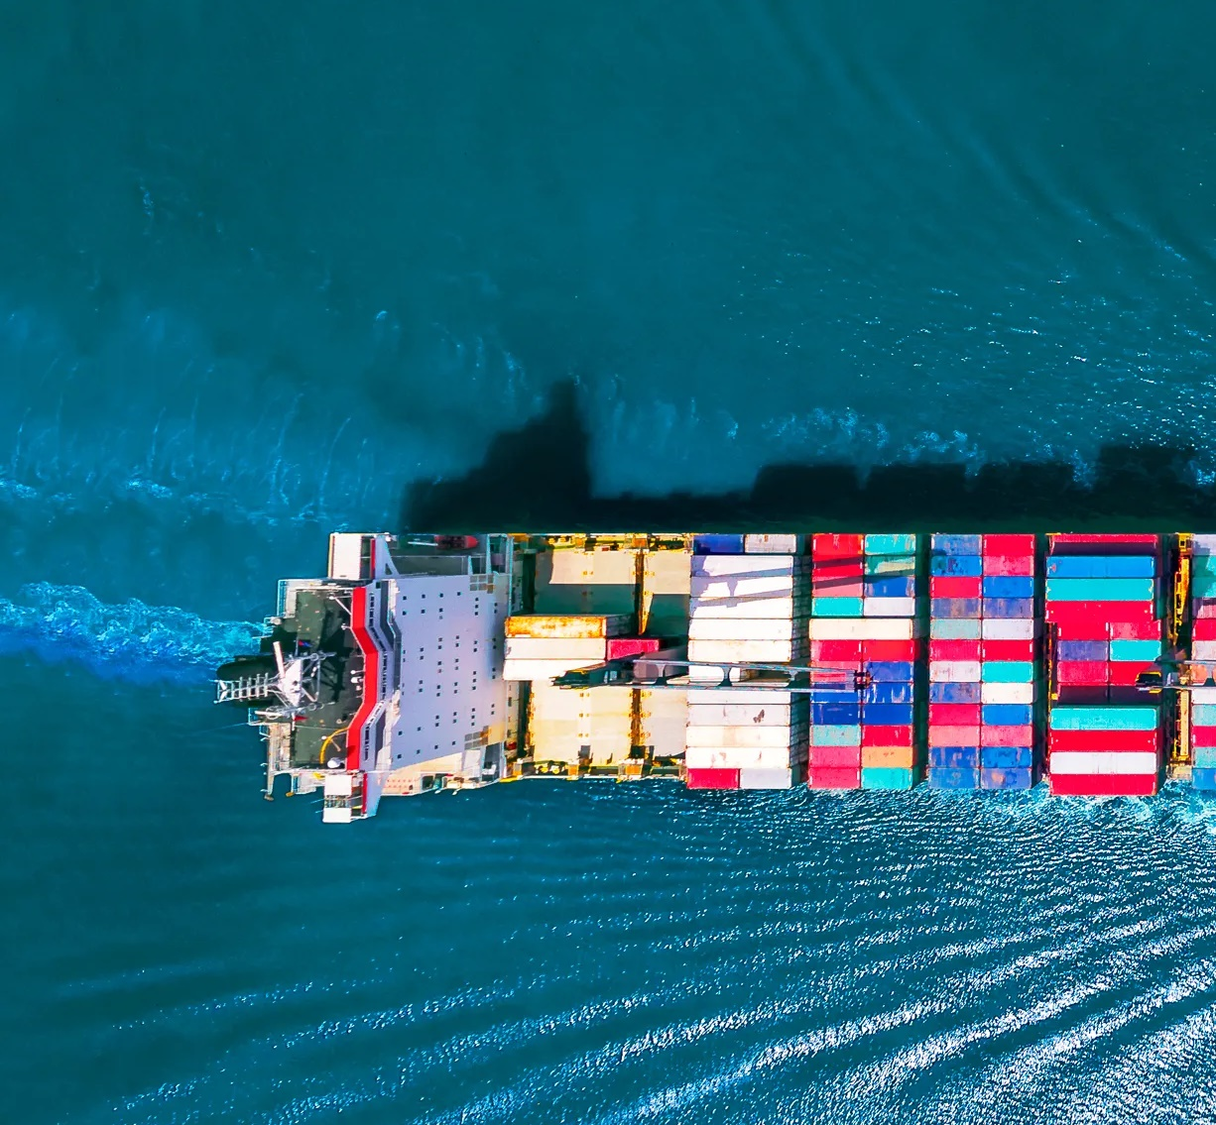
Who are we?
Science, Technology,
Engineering, and Mathematics
SCL
Notes:
Explain what STEM is and why you are presenting to the students today.

Slide 3
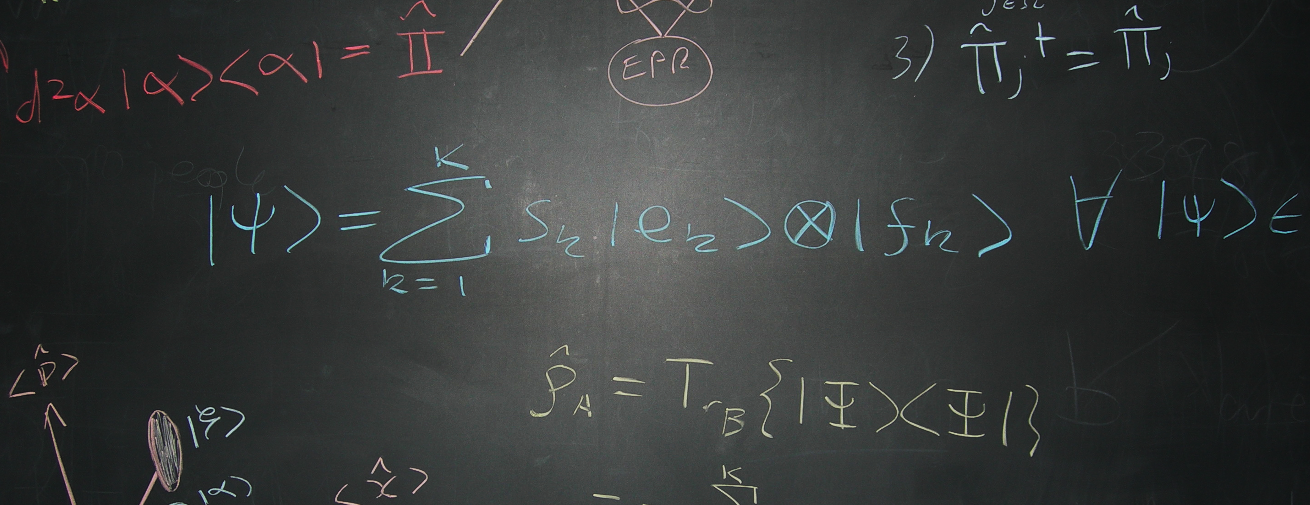
Name – Job Title
Notes:
A template slide for you and your colleagues to introduce yourselves and briefly discuss what you do in STEM. Duplicate as necessary. Replace with your own pictures.

Slide 4
Lesson Plan
Density
Buoyancy
Cardboard Boat
Notes:
Explain the main topics that this lesson will cover.

Slide 5
Density
Notes:
Introduction slide for density.

Slide 6
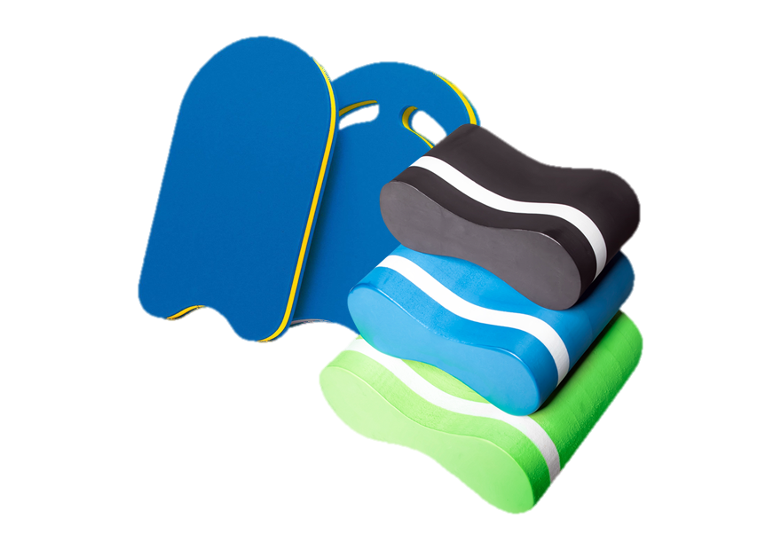
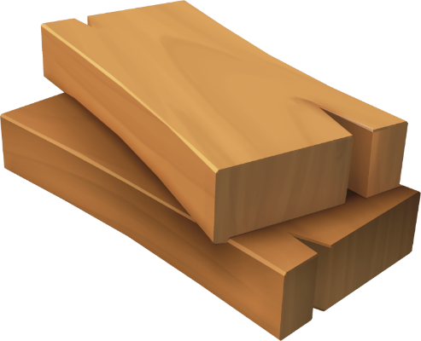
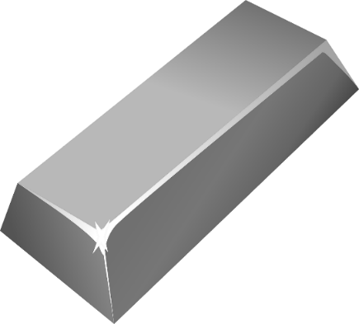
Will it float?
SCL
Notes:
Bring along some objects to test whether they will float or sink. Ask the students to predict the outcome before placing objects in the water.

Slide 7
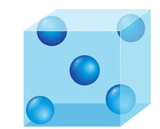
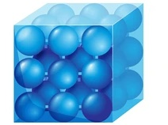
Will it float?
SCL
Notes:
Explain:
Different objects have different densities.
Objects are made up of molecules, and denser objects have more tightly packed molecules.
If an object has a higher density than water, it will sink.

Slide 8
Buoyancy
Notes:
Introduction slide for buoyancy.

Slide 9
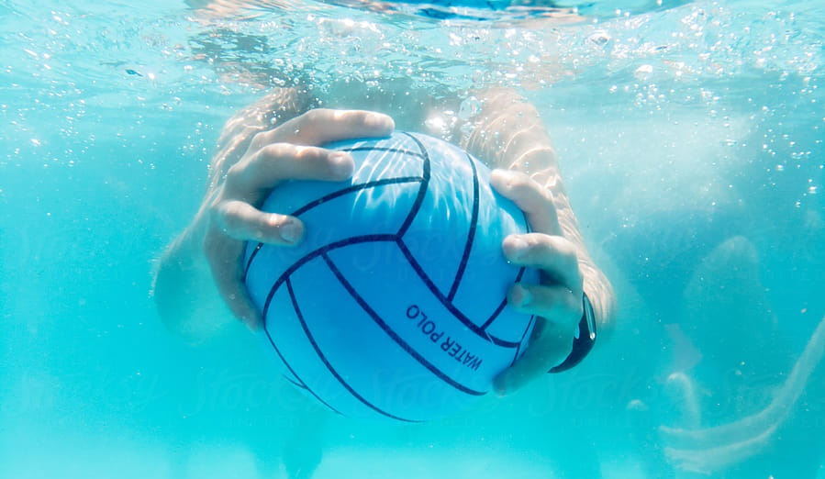
Buoyancy
SCL
Notes:
Ask the students what the two main forces acting on the ball are.

Slide 10
Buoyancy
Buoyancy Force
SCL
Person Pushing Down
Notes:
Explain that the two main forces are the buoyancy force and the force of the person pushing down (gravity on the ball is also present as a force if they pick it up).

Slide 11
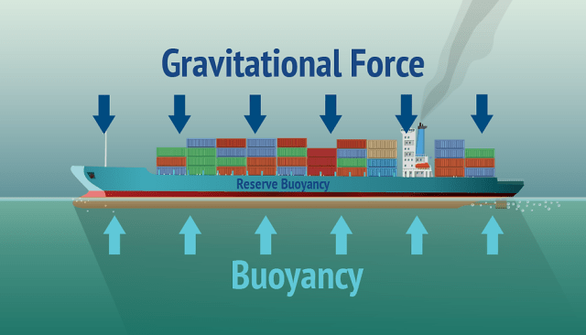
SCL
Notes:
Explain that on a boat, two main forces act on the hull.

Slide 12
Buoyancy Force
SCL
Weight
Notes:
The buoyancy force opposes the weight/gravitational force.

Slide 13
Buoyancy Force
Weight of ship =
Weight of Displaced Water
SCL
Weight
Notes:
The buoyancy force is equal to the weight of the displaced water.

Slide 14
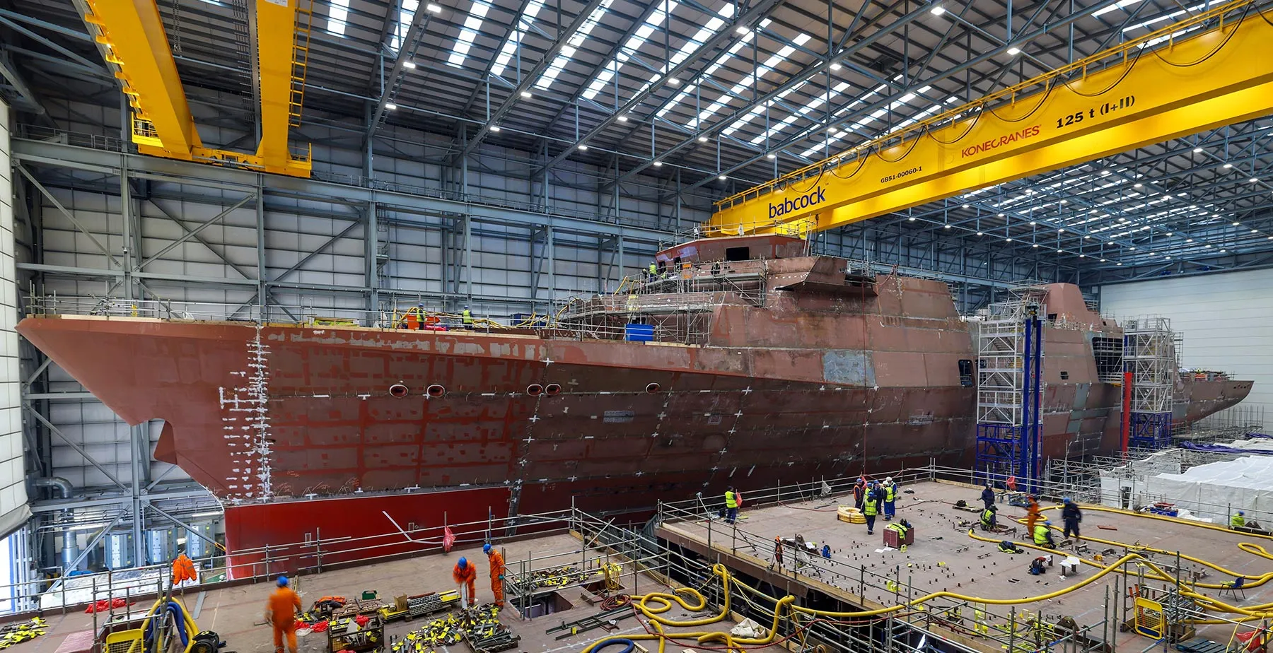
Ship Building
Notes:
Explain that engineers use this principle to ensure ships float when designing them. Example: The Royal Navy’s Type 31 frigate, currently being built in Fife, Scotland.

Slide 15
Cardboard Boat Challenge!
Notes:
Introduction slide for the cardboard boat challenge.

Slide 16
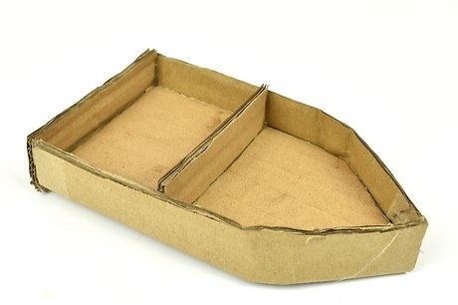
Cardboard Boat Challenge!
SCL
Notes:
Explain the challenge and show the weights.

Slide 17
Making 3D shapes from 2D shapes
3D shapes can be folded together from 2D shapes
Make your own 3D boat from cardboard sheets
SCL
Notes:
Explain to students that they can make a boat by folding the cardboard. If you have premade examples, show them.

Slide 18
Information
TimeLine
5 mins of design time
30 mins of build time
Test time!!!
Build Items
Cardboard
Scissors
Tape
Coloured pens or Pencils
SCL
Notes:
Explain the cardboard boat challenge again, then start!

Slide 19
Thank you!!!
SCL
Notes:
Exit slide.

